Slide 1

Stock price prediction.
Elie Ghazzoul
Alberto Stigliani
Robert Roman

Slide 2

Table of content
Introduction.
Research question.
Strategy.
Steps.
Benefits.
Results.
Biases/ Suggestions.
Conclusion & further research.

Slide 3
Introduction:
Gather data from tech stocks before covid 19 from Yahoo finance
Divide the task into quantitative, fundamental and technical analysis
Use python in collab to put into action our analysis
Apply different analysis on the stocks to have an approximated prediction
Compare the prediction with the actual prices of the given year
Simulate different models on the analysis to be able to refute models and accept some
Visualize the models obtained

Slide 4
Research Question:
Can we establish a model to predict in some way future stock prices?

Slide 5
Strategy
Quantitative Analysis:
Implement a mix of machine learning algorithm to predict the future stock price of this company, starting with simple algorithms like averaging and linear regression, and then move on to advanced techniques like LSTM.
Technical Analysis:
Calculation of selected features, trainging of predictive models and evaluation of results, followed by parameter optimization to enanche performance.
Finding the best model to predict future stock prices based on technical analysis
Fundamental Analysis:
Utilize historical stock data and financial ratios to train a predictive model.
Aim to forecast future stock prices based on past performance.

Slide 6
Steps
Quantitative Analysis:
Feature Engineering: Create additional features that might help improve the predictive power of your model.
Model Building: Select an appropriate machine learning or statistical model for predicting stock prices.
Validation: Validate the performance of your model(s) using a separate validation dataset to ensure they generalize well to unseen data.
Technical Analysis:
Features Engigneering : choice and computation of the features
Training and prediction across multiple models
Parameter tuning
Fundamental Analysis:
1. Financial Ratio Calculation: Compute Price-to-Earnings (P/E), Price-to-Sales (P/S), and Price- to-Book (P/B) ratios.
3. Data Preparation: Merge datasets and split into training and testing sets.
4. Model Training: Train a Linear Regression model using the training data.
5. Model Evaluation: Assess model performance using metrics like MSE, R2, MAE, and MedAE.

Slide 7
Benefits
Quantitative Analysis:
Quantitative analysis relies on concrete data and mathematical models to evaluate stocks. This helps in making objective investment decisions based on facts rather than emotions or subjective opinions.
Technical Analysis:
This analysis provides a rich set of indicators that capture different aspects of price behavior.
Incorporating these indicators as features in the model allows it to learn from relevant market signals and historical trends.
Technical indicators respond dynamically to changing market conditions. By incorporating them into the model, it becomes more adaptable to different market regimes (e.g. trending, ranging, or volatile markets) This adaptability improves the model's robustness and accuracy.
Fundamental Analysis:
Improved Investment Decisions: Make informed investment choices based on predictive insights.
Risk Management: Better manage risks associated with stock investments.
Potential for Higher Returns: Capitalize on opportunities by predicting future price movements.
Competitive Advantage: Gain an edge over other market participants through data-driven analysis.

Slide 8
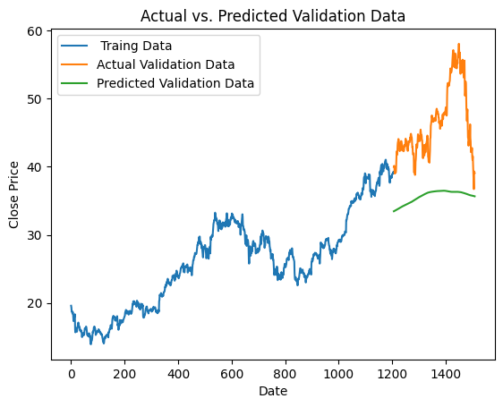
Moving average Model
RMSE value on training set: 225.97114967006482
RMSE value on validation set: 11.727854076068352
The high RMSE on the training dataset(more than 8 times the mean),indicates that my model has a poor performance. Despite its lower RMSE on the test set, that could be because our test set is relatively small, it's a bad model.
Poor performance, as expected from the RMSE

Slide 9
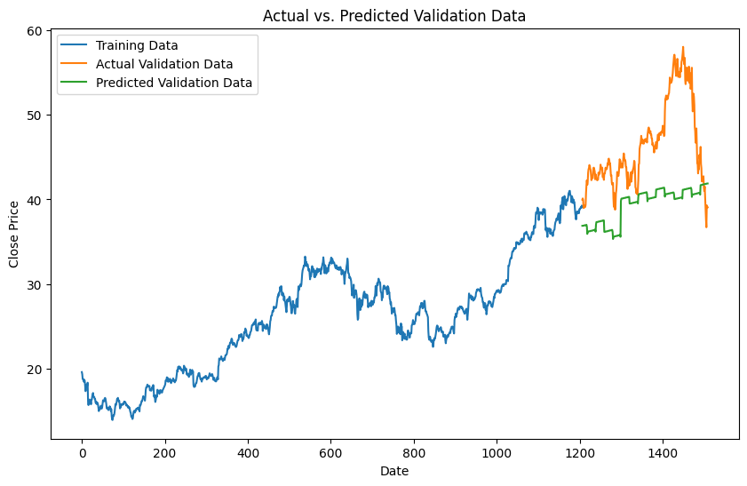
Linear regression
Feature engineer: my hypothesis is that the first and last days of the week could potentially affect the closing price of the stock far more than the other days. So I have created a feature that identifies whether a given day is Monday/Friday or Tuesday/Wednesday/Thursday
RMSE on training set: 3.2240702587742143
RMSE on test set:
8.333344515274565
It's better than the moving average model , but it's not quite accurate

Slide 10
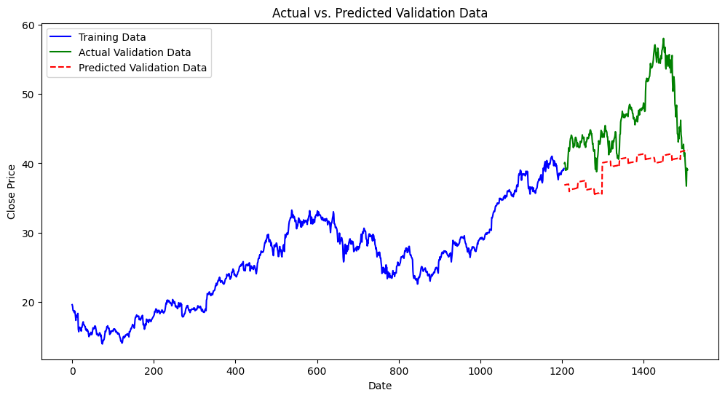
KNN model
RMSE on training set: 1.6647127547820053
RMSE on test set: 15.452655357764467
This model is clearly overfitting the dataset
Then it is not a good model

Slide 11
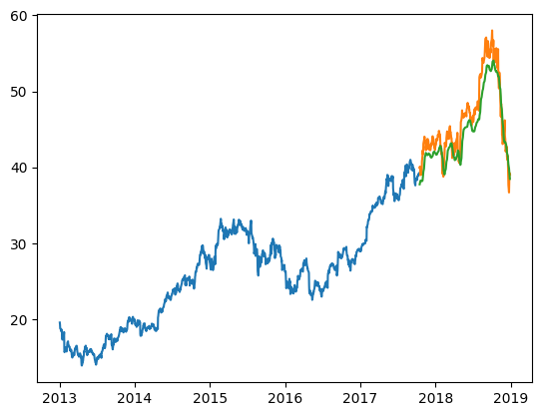
LTSM
LSTMs are widely used for sequence prediction problems and have proven to be extremely effective. The reason they work so well is because LSTM is able to store past information that is important, and forget the information that is not.
The LSTM model can be tuned for various parameters such as changing the number of LSTM layers, adding dropout value or increasing the number of epochs.
The RMSE is : 2.2529864880831276

Slide 12

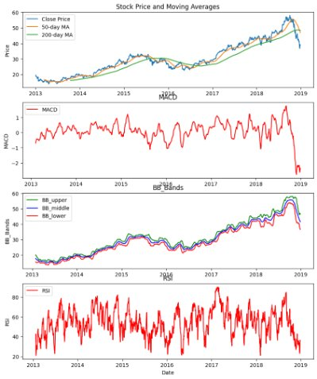
Apple Features computation
50-Day Moving Average is often use to gauge intermediate-term trend.
200-Day Moving Average is used to identify the overall trend and potential support-resistance levels
The Moving Average Covergence Divergence shows the convergence or divergence of moving averages. MACD can be used to identify aspects of an asset’s overall trend, assess momentum, trend direction, and duration.
The Bullinger Bands are a popular momentum indicator to evaluate the trend or the overbought/oversold situation of an asset
The Relative Srenght Index is an indicator used to identify overbought or oversold conditions in the market, measuring the strenght and speed of market's price movement

Slide 13
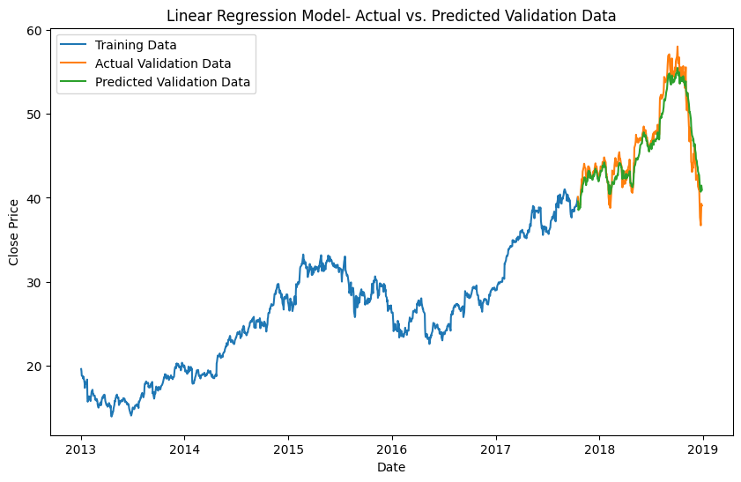
Linear Regression Model Prediction
The linear regression model is a statistical technique employed to model the relationship between a dependent variable (target) and one or more independent variables (features).
It assumes a linear relationship between these variables and seeks to identify the optimal straight line that best represents this relationship.
The model's low mean squared error (MSE) and high coefficient of determination (R²) indicate that it has overfit the data.
Overfitting can result in inaccurate predictions on new data and undermines the model's capacity to generalize beyond the training dataset.

Slide 14
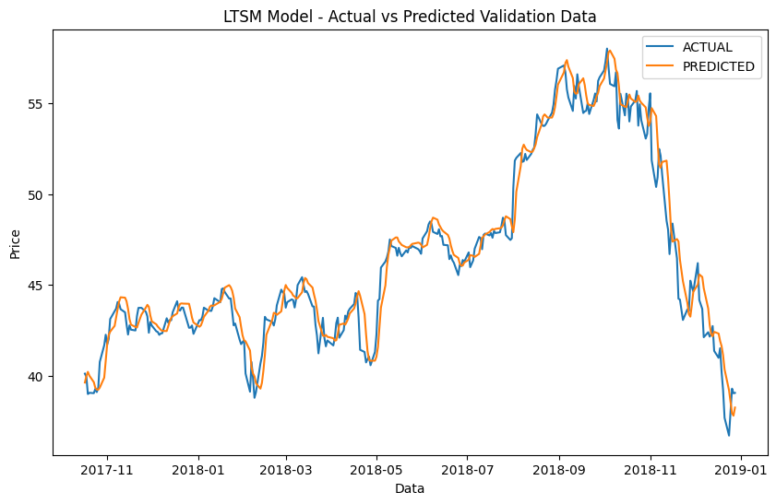
Long Short-Term Memory Model Prediction
The Long Short-Term Memory (LSTM) model is a type of recurrent neural network (RNN) architecture designed to process and predict sequential data, such as time series.
It is particularly effective in capturing long-term dependencies in data by maintaining a memory state.
The model comprises interconnected nodes (or cells) that regulate the flow of information based on input sequences.
The LSTM is trained to learn patterns and relationships in sequential data, making it suitable for tasks like stock price prediction.

Slide 15

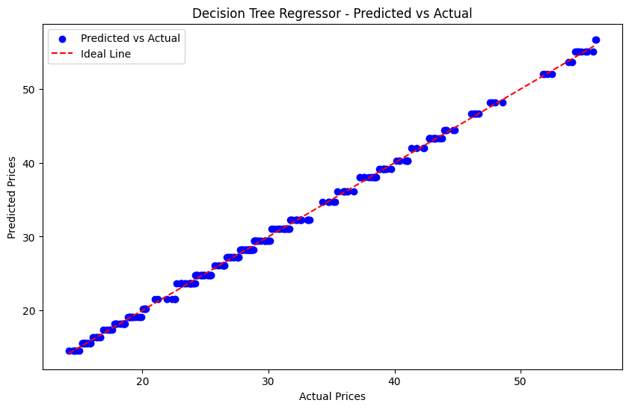
Decision Tree Regressor Model
The Decision Tree Regressor model is a supervised learning algorithm used for regression tasks.
This model works by recuresively partitioning the dataset into subsets based on the values of certain features.
The split points are chosen to minimize impurity within each subset. The model continues splitting until a stopping criteria is met
The goal of the model is to find the best way to split the dataset to maximize the explained variance in the target variable.

Slide 16
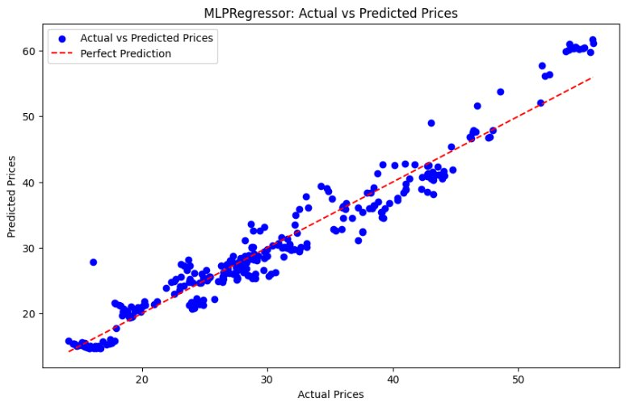
Multi-layer Perceptron Regressor Model
The MLPRegressor model is a type of artificial neural network that consists of multiple layers of artificial neurons, each connected to subsequent layers through adjustable weights.
Each neuron computes a linear combination of its inputs followed by a nonlinear activation function to learn a function that maps input features to a continuous output.
During training, the model adjusts the weights of connections between neurons to minimize a loss function, such as the mean squared error (MSE).
However, it can be sensitive to parameter choices, such as the number of hidden layers, number of neurons per layer, type of activation function, and learning rate.

Slide 17
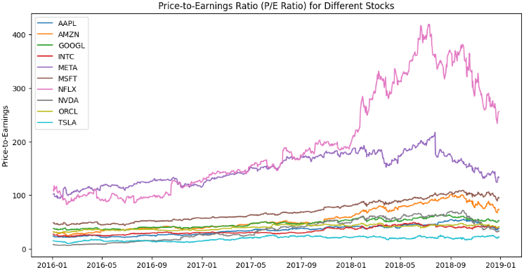
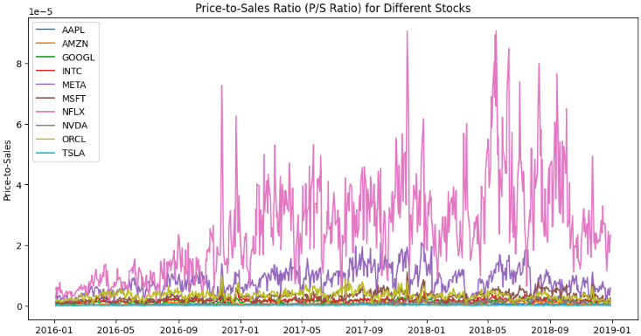
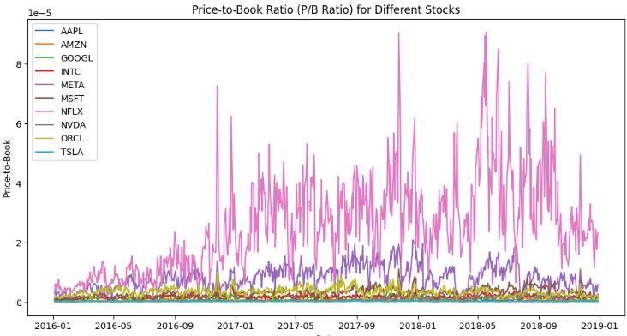
Fundamental Analysis

Slide 18
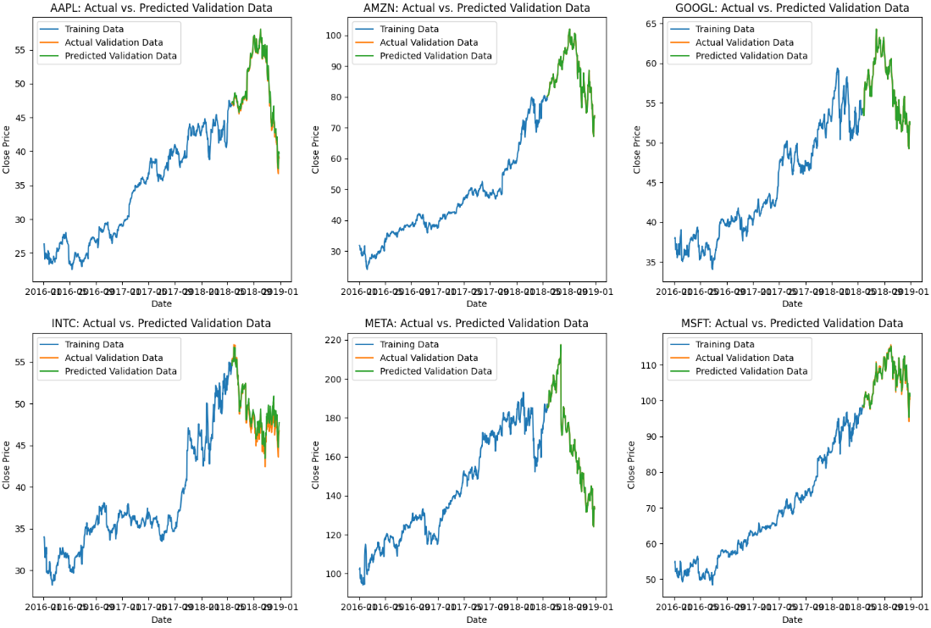
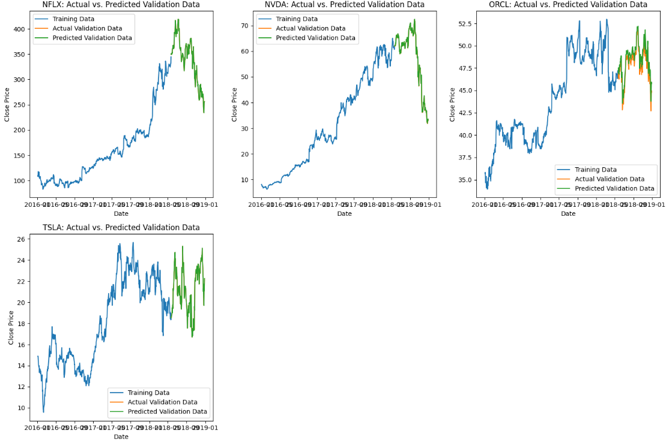
Linear Regression Model

Slide 19
Biases
Technical analysis is based on the belief that historical patterns tend to repeat.
Selection of a limited number of features used for technical analysis
Fill the NaN values of the features (due to the fact that their calculation requires information prior to the reference dataset) with their means.
Consider biases introduced by data quality or representativeness.
Model Assumptions: Acknowledge assumptions underlying the predictive algorithms.

Slide 20
Suggestions
Improvement of models through the use of a higher number of features.
Combination with other analysis
Continuous Monitoring: Regularly update the model with new data for improved accuracy.
Collaboration: Collaborate with domain experts for insights and validation.

Slide 21
Conclusions & Further Research
External Factors: Account for external events or market dynamics not captured by the model.
Stock price is affected by the news about the company and other factors like demonetization or merger/demerger of the companies.
There are certain intangible factors as well which can often be impossible to predict beforehand.
Overfitting: Mitigate risks of overfitting in model training because of the ratios chosen.
Ethical Considerations: Ensure transparency and fairness in model development and deployment.

Slide 22


